Slide 1
Video on verification – to be used in group discussions
Norwegian oil and gas association

Slide 2
Agenda
Hydrocarbon leak causes
Video on verification
Discussion in groups

Slide 3
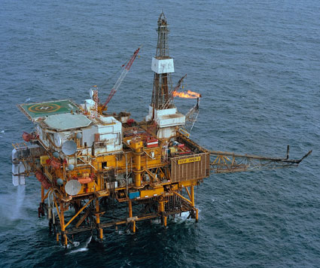
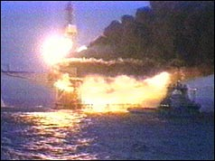
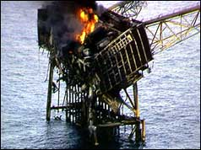
Major accident example
Piper Alpha accident in 1988:
Leak (2 kg/s) → ignition → explosion → fire → 167 fatalities.
Misunderstandings between day shift and night shift whether or not a job (PSV replacement) was initiated.
Before
During
After

Slide 4
Hydrocarbon leaks categorization
Hydrocarbon leaks above 0.1 kg/s on the Norwegian continental shelf in 2008-2013
[n=62]
Almost two out of three leaks were related to work on hydrocarbon equipment (pink sector)
Most of this work was carried out in the operations phase (not during annual shutdowns)

Slide 5
Examples
Flange bolts with wrong torque
Opened the wrong valve
Forgot to reinstate a plug
Reinstated too early
Used the wrong kind of gasket
Worked on wrong (pressurised) equipment

Slide 6
Leaks related to human intervention on hydrocarbon equipment (pink sector)
[n = 38, 2008-2013]
Errors during isolation and reinstatement are important causes to hydrocarbon leaks!

Slide 7
Important principles to prevent such leaks
Systematic use of isolation plan
Verification of all critical tasks: One person performs and another person verifies

Slide 8
Video on verification
The film is started by clicking one of the buttons below. Please note:
The computer must be connected to the internet
PowerPoint must be in «presentation mode»
The resolution can be adjusted by clicking «settings» in the lower right corner. Choose 1808p if you have a fast internet connection
No subtext
English subtext
Both versions have Norwegian speech
Link to Norwegian version and English version

Slide 9
Discussion in groups

Slide 10
Task 1
In which cases should isolation plan and verification be used?
  During isolation and reinstatement when a valve is removed and replaced?
  During certification of a PSV?
  When a pig is going to be launched?

Slide 11
Task 2
How should the verification be performed in practice?
  Should the verification always be performed in field?
  Can the person performing the isolation and the person performing the verification go together?
  How can we ensure the two roles are separated?

Slide 12
Task 3
Verification is required, but you are the only process operator on your shift. What do you do?

Slide 13
Task 4
Pilots use check lists before take-off even though they perform this work task several times every day. Why?

Slide 14
Summary
In average there is one leak every 10th year per platform on the Norwegian continental shelf (>0,1 kg/s). This equals one leak every 30th year per shift.
Hydrocarbon leaks can result in a major accident like on Piper Alpha. We have to do whatever we can to prevent such an accident.
Everybody makes an error from time to time. At least in 30 years!
This is why we need strict rules for the use of isolation plans and verification.
You are the pilot offshore!

Slide 15
More information
www.norskoljeoggass.no/hydrokarbonlekkasjer

